Slide 1

Effects of Non-Darcy flow on Worst Case Discharge Calculation
Youssuf A. Elnoamany
Spring 2020 Well Completion Design
Final Project Presentation
Dr. Richard G. Hughes

Slide 2
Outline
Introduction
Background
Objective
Inflow Performance Relationship IPR’s
Tubing Performance Curve TPC
Model Parameters
Results
Future Work
Acknowledgments
References

Slide 3
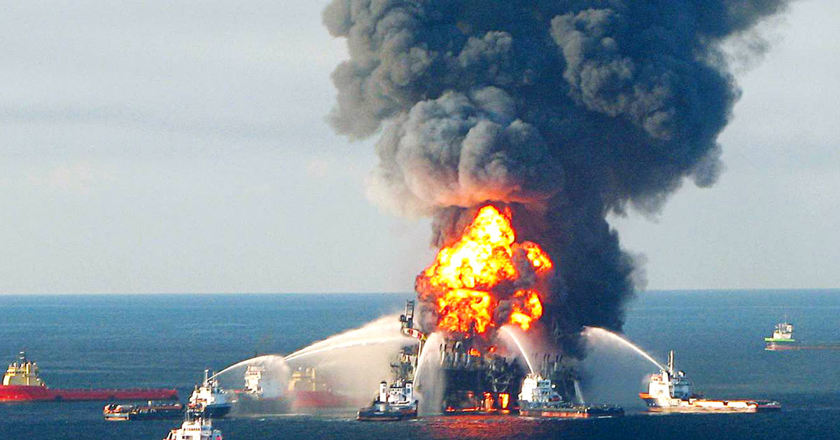
Introduction: Worst Case Discharge (WCD)
WCD is defined by BOEM as, “the maximum daily flowrate from an offshore well in the event of a blowout”.
In prominence after the Macondo oil spill (2010).
Determined using traditional nodal analysis technique.
Very-high rate oil wells supported by the large pressure drop.
Macondo oil well under blowout (Ansys.com)

Slide 4
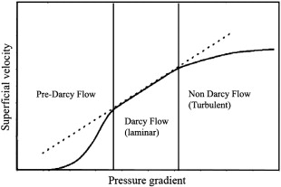
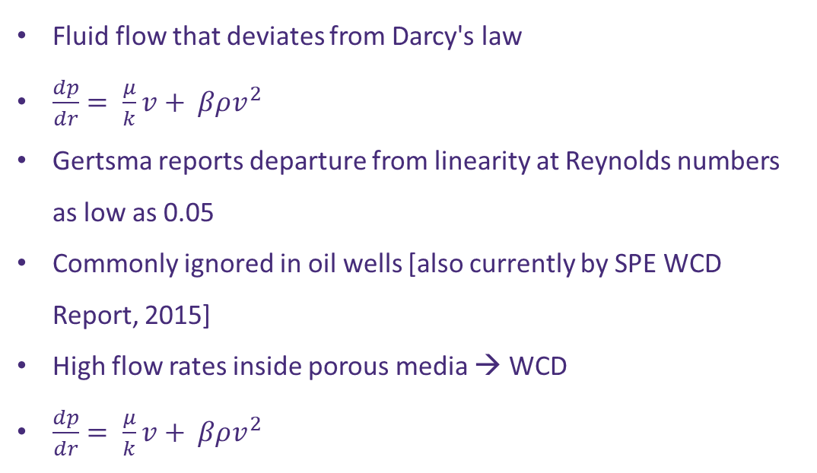
Background: Non-Darcy flow
Fluid flow that deviates from Darcy's law
$\frac{dp}{dr}= \frac{μ}{k}v+ βρv^{2}$
Gertsma reports departure from linearity at Reynolds numbers as low as 0.05
Commonly ignored in oil wells [also currently by SPE WCD Report, 2015]
High flow rates inside porous media → WCD
$\frac{dp}{dr}= \frac{μ}{k}v+ βρv^{2}$
(Petrowiki)

Slide 5
Objective
The objective of this work is to quantify the effect of non-Darcy flow in the reservoir on the inflow performance on WCD rate calculation and volume prediction. As an analysis tool, a dedicated numerical model that describes single-phase, 2D, Darcy, and non-Darcy flow toward an openhole well under loss of well control situation.

Slide 6
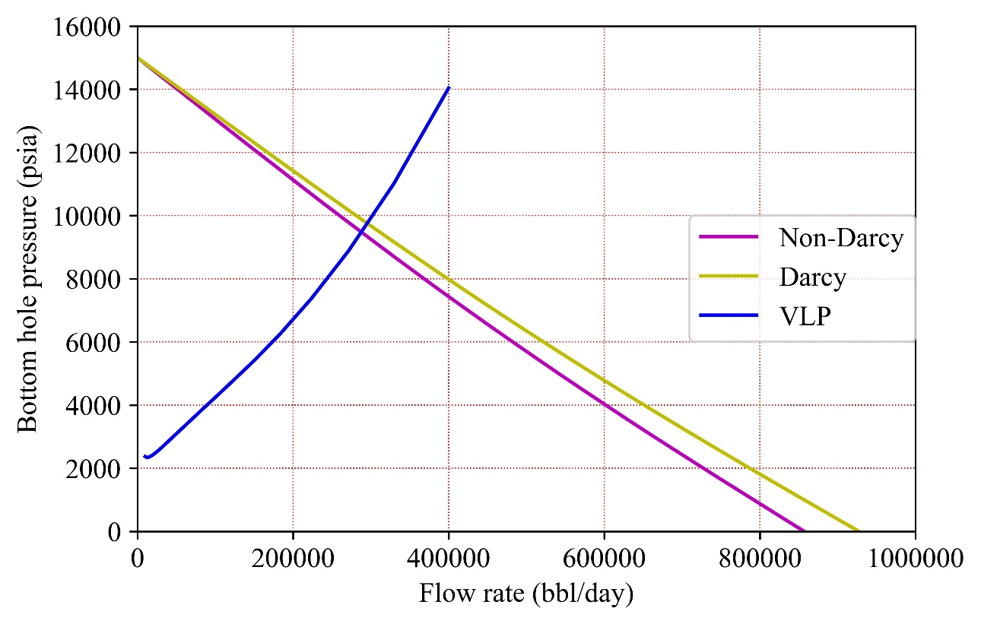
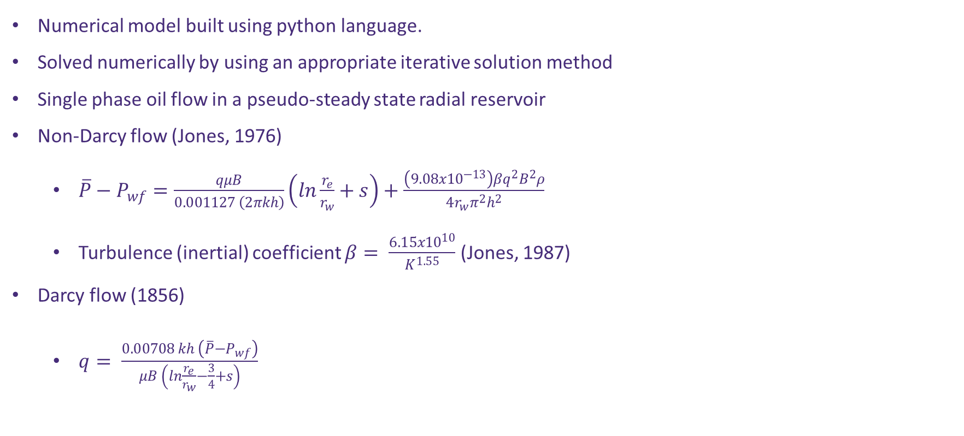
Inflow Performance Relationships IPR’s
Numerical model built using python language.
Solved numerically by using an appropriate iterative solution method
Single phase oil flow in a pseudo-steady state radial reservoir
Non-Darcy flow (Jones, 1976)
$\overline{P}−P_{wf}=\frac{qμB}{0.001127 \left(2πkh\right)}\left(ln\frac{r_{e}}{r_{w}}+s\right)+\frac{\left(9.08{x10}^{−13}\right)βq^{2}B^{2}ρ}{4r_{w}π^{2}h^{2}}$
Turbulence (inertial) coefficient $β= \frac{{6.15x10}^{10}}{K^{1.55}}$ (Jones, 1987)
Darcy flow (1856)
$q= \frac{0.00708 kh \left(\overline{P}−P_{wf}\right)}{μB \left(ln\frac{r_{e}}{r_{w}}−\frac{3}{4}+s\right)}$

Slide 7
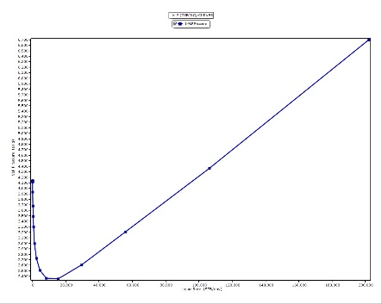

Tubing Performance Curve TPC
Using PETEX, 2019 IPM suite (PROSPER – GAP)
Hagedorn & Brown, 1964 empirical correlation
Generic multiphase flow pressure gradient equation
$\frac{dp}{dz}=\frac{g}{g_{c}}\overline{ρ}+\frac{2f\overline{ρ}{u_{m}}^{2}}{g_{c}D}+\overline{ρ}\frac{∆\left({{u_{m}}^{2}}/{2g_{c}}\right)}{∆z}$
$95/8$in casing (8.5 in ID) is set at true vertical
depth (TVD) of 16100 ft
Seafloor depth, $h_{w}$ = 5100 ft
Discharge pressure at $h_{w}$ = 2200 psia
Discharge temperature at $h_{w}$ = 41 F
Casing roughness = 0.0018 in (SPE WCD Report, 2015)

Slide 8
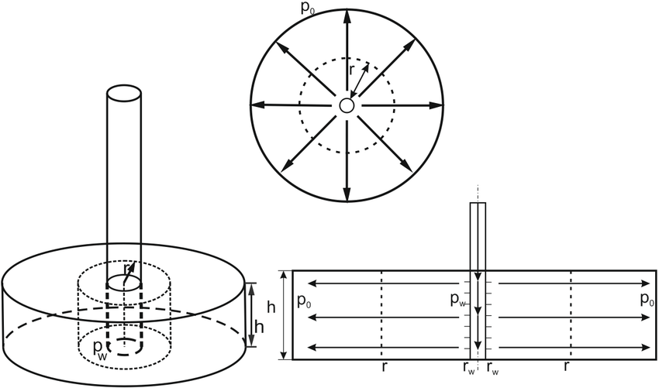

Model Parameters
Initial reservoir pressure, $\overline{P}$ = 15000
True vertical depth, TVD = 17000 ft
Reservoir temperature, T = 200 F
Net pay thickness, h = 100 ft
Permeability, k = 600 mD
Reservoir radius $r_{e}$ = 15000 ft
PVT = Vasquez and Beggs (Hughes R, 2002)
Oil gravity = 31.5 API
Bubble point pressure = 3400 psia
Initial GOR = 500 scf/stb
Gas specific gravity = 0.6
Turuntaev (2017)

Slide 9
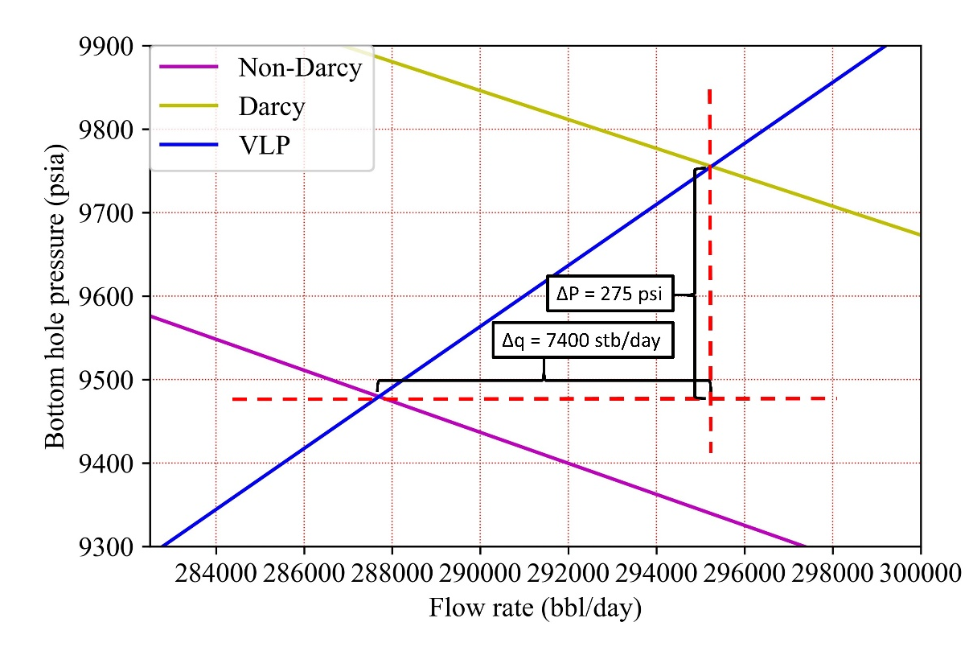
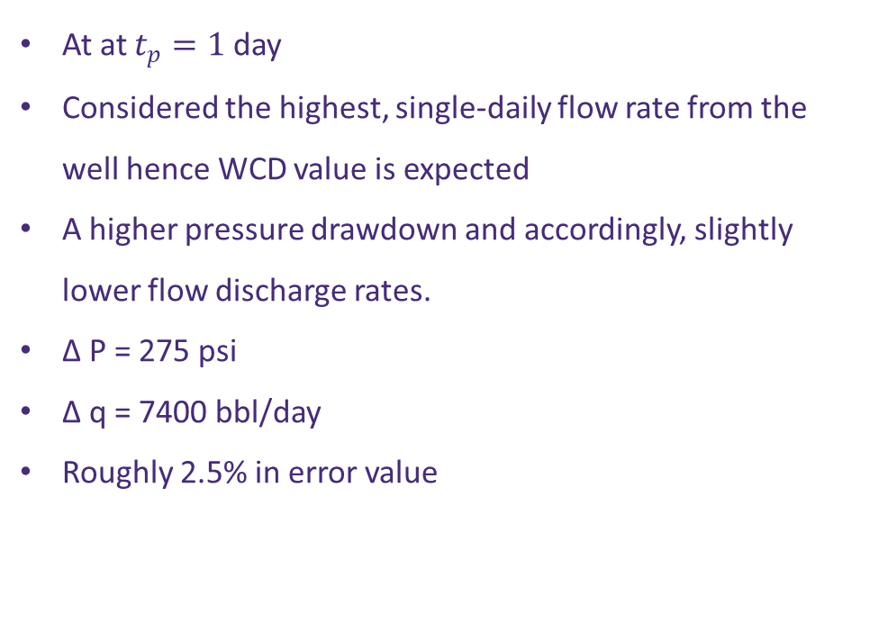
Results
At at $t_{p}=1$ day
Considered the highest, single-daily flow rate from the well hence WCD value is expected
A higher pressure drawdown and accordingly, slightly lower flow discharge rates.
Δ P = 275 psi
Δ q = 7400 bbl/day
Roughly 2.5% in error value

Slide 10
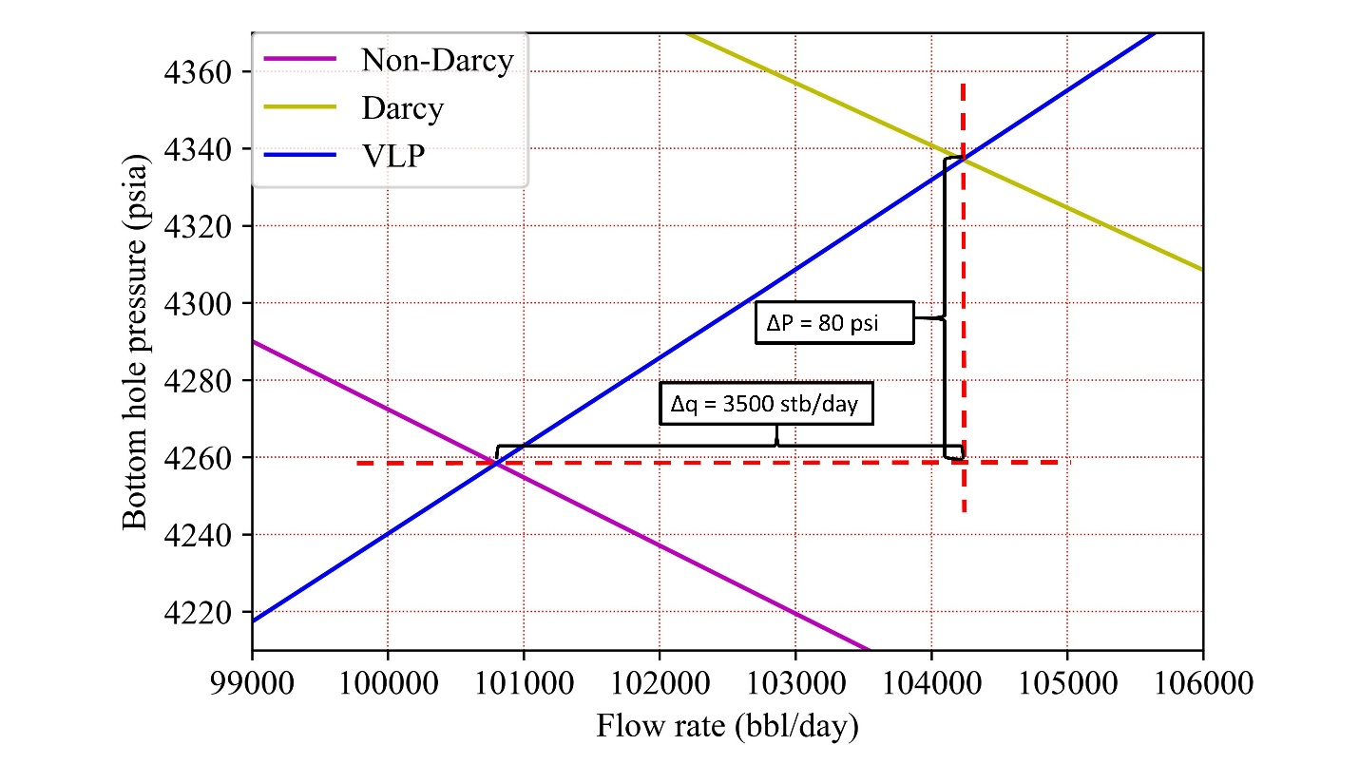
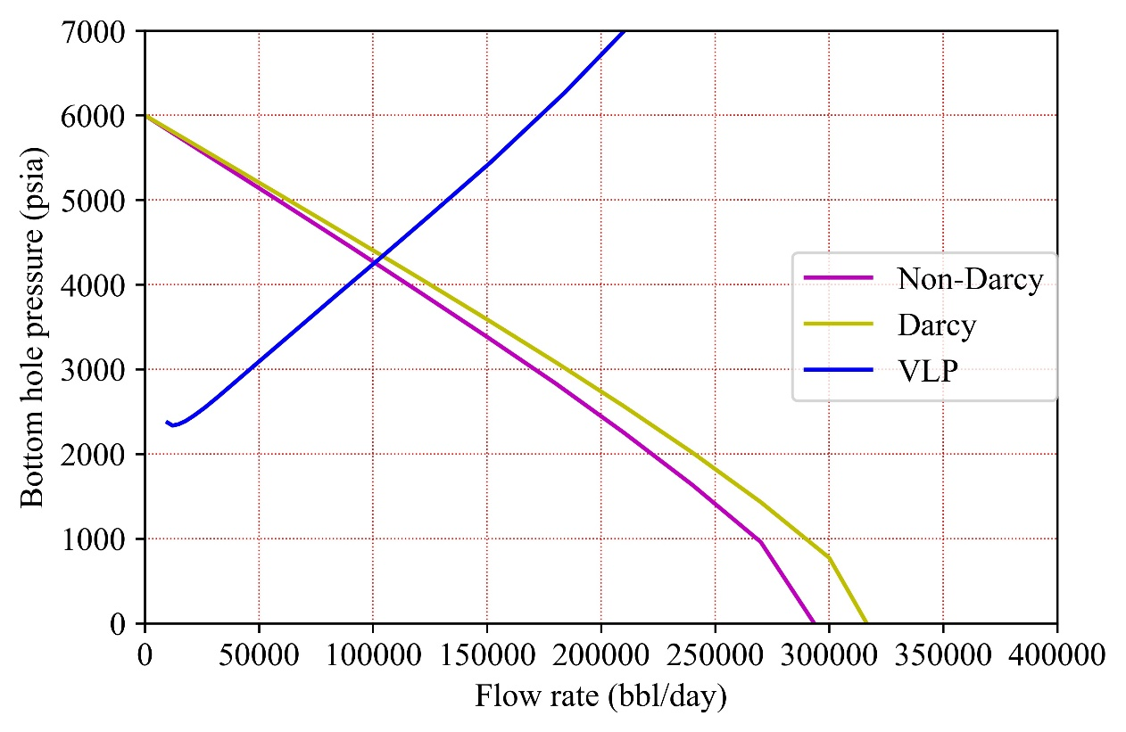
Results (cont’d)
Coupled reservoir-material balance through MBAL
Average reservoir parameters after 80 days
Lower pressure drop and consequently, lower difference in oil rate prediction
Δ P = 80 psi
Δ q = 300 bbl/day
408000 bbl difference in total cumulative oil produced.

Slide 11
Conclusion
The effect of non-Darcy flow on WCD estimation and total discharge volume of an undergoing loss of well control situation has been investigated.
Compared with Darcy flow IPR, non-Darcy flow will predict a reduced WCD value and consequently, total discharged volume.
An intuitive approach to incorporate non-Darcy flow in WCD estimation the basis of inflow area is a more accurate and rational approximation to the real value as deepwater wells exhibit very high oil flow rates.
Less fines and other penalties imposed by U.S government and federal contracts saving billions of dollars payed by operator companies.

Slide 12

Future Work
Incorporate the Hagedorn and Brown correlation on python
Coupling material balance for forecast oil production using python (Dynamic modeling)
Pressure and saturation dependent properties
Near-well and wellbore region
Introduce multiphase flow

Slide 13
Acknowledgments
I would like to express my gratitude to my advisor Dr. Ipsita Gupta for the idea and subsequent discussions, as well as Dr. Richard Hughes for enhancing my understanding on the topic through this course. I thank my colleague, Hassan who provided helpful insight in programming

Slide 14
References
Forchheimer. (1901). Wasserbewegung durch boden. . Z. Ver. Deutsch. Ing.,, 45, 1782-1788.
Hagedorn, A. R., & Brown, K. E. (1964). The Effect of Liquid Viscosity in Two-Phase Vertical Flow. Society of Petroleum Engineers. doi:10.2118/733-PA
Hughes, D. R. G. (2002). PVT Properties. Reserve Evaluation and Reservoir Management.
Jones, S. C. (1987). Using the Inertial Coefficient, B, To Characterize Heterogeneity in Reservoir Rock. Paper presented at the 6;!nd Annual Technical Conference and Exhibition of the Society of Petroleum Engineers, Dallas, TX, USA.
Jones., M., B. E., & H., G. O. (1976). Use of To Short Term Multiple Predict Performance Rate Flow of WeIIs Having Turbulence. Paper presented at the 51st Annual Fall Technical Con~erence and Exhibition of the Society of Petroleum Engineers of AIME, New Orleans, LA, USA.

Slide 15
References (cont’d)
Mukherjee, H., & Brill, J. P. (1983). Liquid Holdup Correlations for Inclined Two-Phase Flow. Society of Petroleum Engineers. doi:10.2118/10923-PA
PETEX. (2019). REVEAL-GAP-MBAL-PROSPER (Version 9, 13, 15, 16).
P. Macini, E. Mesini, R. Viola, ”Laboratory measurements of non-Darcy flow coefficients in natural and artificial unconsolidated porous media”, Journal of Petroleum Science and Engineering, Volume 77, Issues 3–4, 2011

Slide 16
Thank you for listening!

